Slide 1
Job Interview
Presenter : Deepti Agarwal
Assistant Professor
HSS,UIET, CSJMU
Kanpur

Slide 2


Slide 3
Outline
Job interview and its purpose
Role of 5 Ps
Importance of nonverbal cues
Don’ts in an interview
Conclusion

Slide 4

Interview
The Merriam Webster dictionary defines interview as ‘a formal consultation usually to evaluate qualifications (as of a prospective student or employee)’

Slide 5

Be Prepared
Dawn Graham is a corporate recruiter. She tweeted that, “One of the easiest ways to increase positive outcomes when interviewing for a job is to prepare”.

Slide 6
What is the purpose of an interview?
Collect Information
Evaluate Information
Evaluate Interviewee
Exchange Knowledge
Generate Information
Increase Knowledge

Slide 7

What features are being evaluated?
Technical skills
Analytical Skills
Career objective
Mental Agility
Communication Skills
Interpersonal skills
Flexibility
Leadership Skills
Creativity

Slide 8
What is the role of 5 Ps?
First P- Planning
Second P- Preparedness
Third P- Persuasiveness
Fourth P- Perseverance
Fifth P- Presentability

Slide 9
Planning Involves
Gather Information:
about yourself
about the prospective company

Slide 10
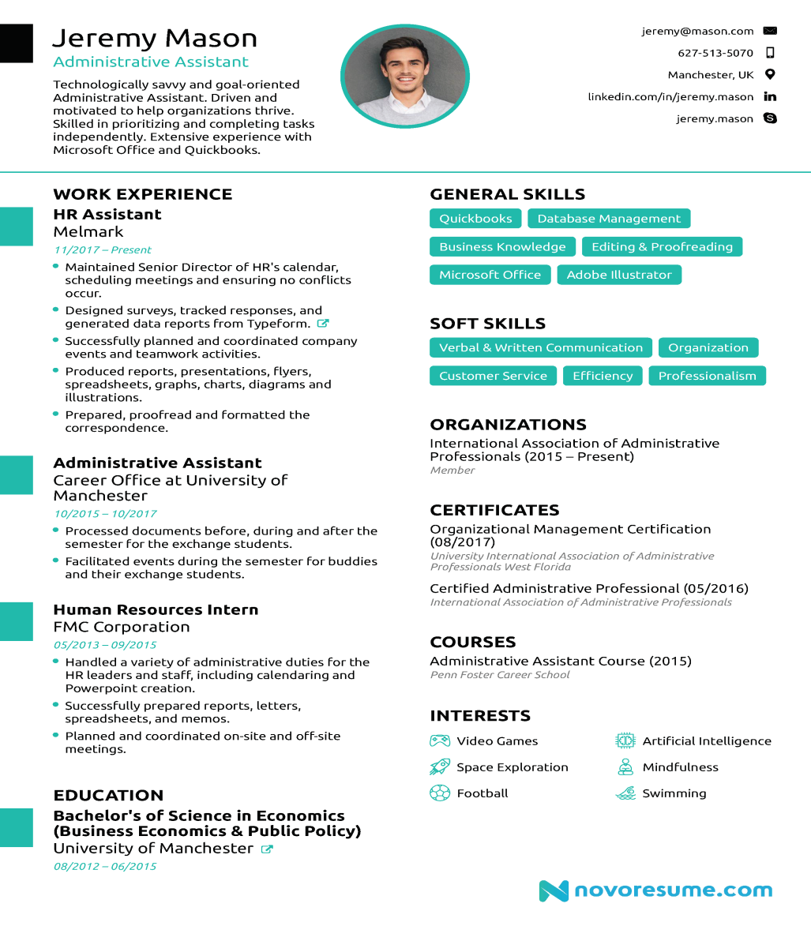
My Professional Information
1. Resume contains:
Academic profile
Technical skills
Soft skills
Achievements
Experiences
Note: Before writing your resume, recall your past experiences.
Know your strengths and weaknesses.
2. Cover Letter
Explain in detail how you are well suited for the job.

Slide 11
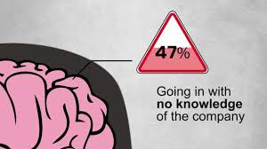
Where am I going to work !

Slide 12
How is planning making you ready for the interview process?
You are ready with the replies for the most common FAQs :
1. Tell us something about yourself.
2. Why should we hire you?
3. How do you fulfil job requirements?

Slide 13
Are you prepared for the day of the interview?
1. To provide information
In folders
Soft copies
2. To face the interviewers
Mock Interview Session

Slide 14
How is persuasiveness exhibited on the day of the interview?
A few Principles empower your interview process:
Honesty- Be truthful with the interviewers
Spontaneity- Build rapport to engage the interviewers
Intrepidity- Be positive throughout the interview process
Faith- Believe in yourself until the end

Slide 15
Tackling the Interview Process Persuasively
1. Active listening
Listen to the questions carefully
Understand the unsaid of interviewers through their body language.(whole body listening)
2. Effective telling
Provide the detailed answers
Substantiate with factual details
Support through examples
Render Clarity

Slide 16
Analyse the reply: What are your strengths?
Why is it an ineffective answer?
Why is it an effective answer?
I am honest, diligent, strong willed, and an efficient communicator.
I am a diligent learner pursuing B.Tech. at UIET, and I have strengthened my skills through certified courses in Machine Learning and Software Design from NPTEL and edX. These experiences, along with participating in national inter-collegiate seminars and competitions, have prepared me to contribute effectively to this organisation.

Slide 17
What are the tips to handle tricky questions?
Three ways to handle
First way: Repeat the question, to buy time for yourself.
Second way: Paraphrase the question, and seek a nod from the panelist.
Third way: To give the disclaimer before hand that you are uncertain but still you would like to make an intelligent guess.

Slide 18
Exhibit Perseverance
If you are dissatisfied with yourself even then….
Don’t be negative
Don’t give up.
Thank the interviewers for an enriching experience.
Reflect on your confidence by asking
Q. What chance do I stand?

Slide 19
What is the role of the 5th P =Presentability?
An interviewee leaves a lasting impression by:
Presenting views
Exhibiting his professional conduct and behaviour

Slide 20
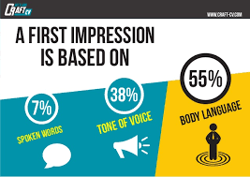
What is a necessary combination for an effective Interview ?
Verbal (Acquired knowledge) + Non-Verbal

Slide 21
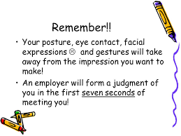

Slide 22


When you are waiting for turn?
Suggested
Avoid

Slide 23

When you are entering A room . . .

Slide 24

Why is A firm hand shake necessary . . .

Slide 25
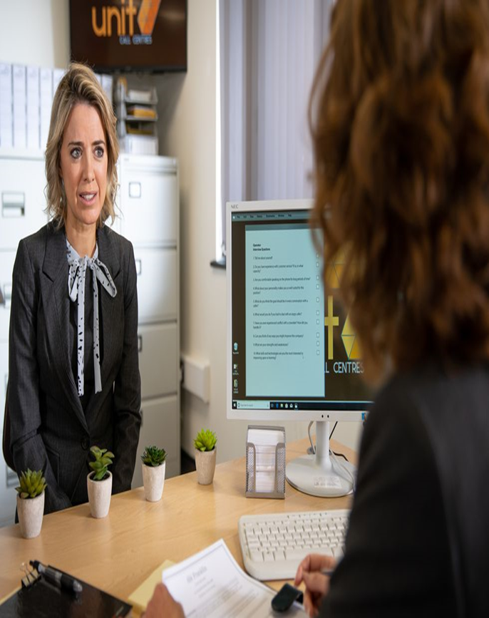

Why should you exhibit confidence?
Am I Interested to talk?
Interested to talk
This Photo by Unknown Author is licensed under CC BY-NC-ND

Slide 26

Are gestures important?

Slide 27
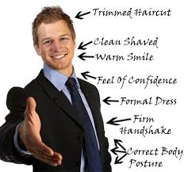

Why should you get dressed with a killer instinct?

Slide 28
Don’ts of an Interview process
Avoid Arrogance
Avoid Apathy
Avoid Uninhibited Nervousness
Avoid Equivocation
Avoid Distraction
Lack of crispness
Lack of social skills

Slide 29
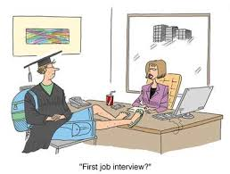
Arrogance . . .

Slide 30

Okay ! I Give up . . .

Slide 31

Avoid Nervousness . . .

Slide 32
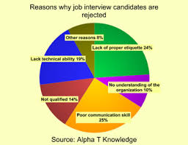
What are the failing factors?

Slide 33
Conclusion
I Believe in Myself
I Believe in Myself
I Believe in Myself

Slide 34
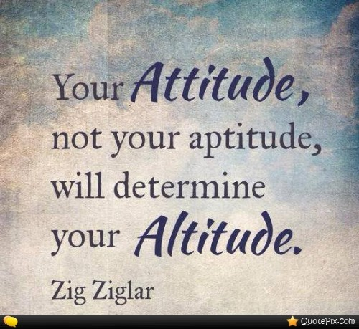

Slide 35


